Slide 1

SWEN20003 Workshop
  Week 07
Demonstrator: Xulin Yang

Slide 2
Workshop tasks
Go through questions
Divide groups by records
Do questions Q1, 2, 3 together
Take attendance

Slide 3
Interface

Slide 4
What is an interface, and how is it different to inheritance?

Slide 5
What is an interface, and how is it different to inheritance?
An interface is used to define the behaviors or actions of several classes that may not have anything else in common and represent a "can do" relationship;
E.g.: Houses and Furniture can both be constructed, but they don't have much in common to warrant inheritance.
Inheritance is used to pass common information from one class (parent) to its subclasses (children) and represents an “is a” relationship; Dogs, Cats, and Birds are all Animals, so all share a name.
In my opinion:
  interface only methods, inheritance have attributes + methods
  Interface (can do relationship), inheritance (is a relationship)

Slide 6
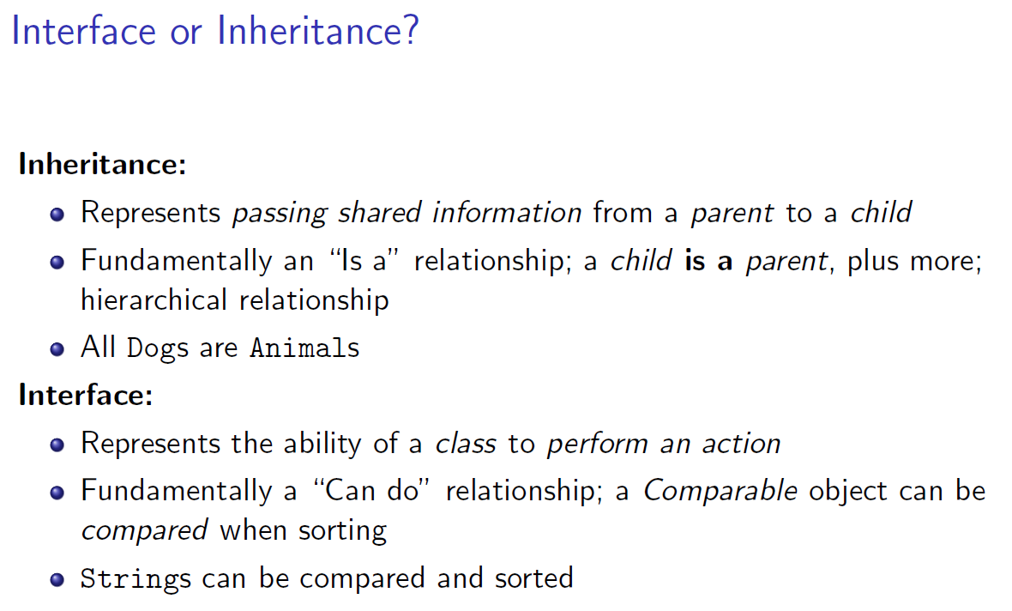
In what situations would we choose one (or more) interfaces over inheritance?

Slide 7
In what situations would we choose one (or more) interfaces over inheritance?
Interfaces are the preferred abstraction when there are no (or few) common properties, or no logical parent-child relationship, between classes that share behaviors.
In my opinion:
  No attributes only methods (i.e. no common property) -> interface
  Can do relationship -> interface
  Note that you can have constants defined in interface

Slide 8
Define an interface called Playable, that allows objects to be “played”. What objects do you think might use this interface, and why are we not using inheritance?

Slide 9
Define an interface called Playable, that allows objects to be “played”. What objects do you think might use this interface, and why are we not using inheritance?
public interface Playable {
public void play();
}
Who use? Instruments, video games, music, and sports, are all examples of things you can play -> these class implements Playable
Why? there is no logical relationship between them, so inheritance doesn't make sense.

Slide 10
What is the Comparable interface?
What implementations of compareTo might we use to compare two: Students; Fruits; Players?

Slide 11
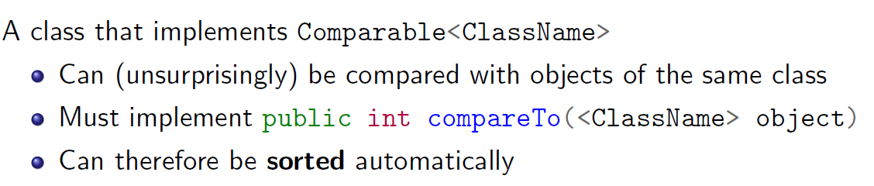
What is the Comparable interface?
What implementations of compareTo might we use to compare two: Students; Fruits; Players?
Implementing the Comparable interface allows a class to be ordered or sorted. There are plenty of different ways to sort a class, but here are some examples:
public int compareTo(Student student) {
return this.studentID - student.studentID;
}
public int compareTo(Fruit fruit) {
return this.colour.compareTo(fruit.colour); // Assume Colour implements Comparable
}
public int compareTo(Player player) {
return this.winRate - player.winRate;
}

